Slide 1
An Association Network for Computing Semantic Relatedness
Keyang
2014/10/8

Slide 2
What Is Association
A connection between concepts in the mind or imagination
In Chinese, approximately equivalent to the term "联想"
Associate from A to B: from A we can think of B

Slide 3
Overview
Semantic Relatedness Computation
Related Work
Association Network
  Free Association Network
  Synthetic Association Network
Experiment Results

Slide 4
Overview
Semantic Relatedness Computation
Related Work
Association Network
  Free Association Network
  Synthetic Association Network
Experiment Results

Slide 5
Semantic Relatedness
Between two language units A and B
  Terms
  Sentences
  Documents
Measure how much A has to do with B
More general than semantic similarity
Based on meaning, as opposed to lexical similarity

Slide 6
Real-world Applications
Semantic search
  Results ranking
Machine translation
  Word sense disambiguation
Text classification
Text summarization
...

Slide 7
Word Sense Disambiguation
The cat found the mouse. | 猫发现老鼠。
The cat accidentally found the mouse. | 猫无意中发现鼠标。

Slide 8
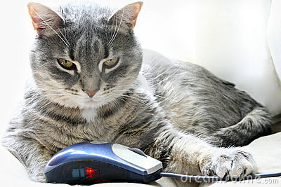

Slide 9
Word Sense Disambiguation
The cat found the mouse. | 猫发现老鼠。
The cat accidentally found the mouse. | 猫无意中发现鼠标。

Slide 10
Relatedness Computation Tasks
Ground truth
  Scored by several people, then average
Criterion: correlation with ground truth
  Pearson
  Spearman
Two tasks we aim to solve
  Term
  Sentence (short text)

Slide 11
Benchmark Datasets
Term relatedness
  Word Similarity-353
Sentence relatedness
  Li-30

Slide 12
Term Relatedness
Term1 | Term2 | Score
car | automobile | 8.94
car | train | 6.31
car | drink | 3.04

Slide 13
Benchmark Datasets
Term relatedness
  Word Similarity-353
Sentence relatedness
  Li-30

Slide 14
Sentence Relatedness
Sentence1 | Sentence2 | Score
I am so hungry I could eat a whole horse plus dessert. | I could have eaten another meal, I'm still starving. | 3.06
Flies can also carry a lot of disease and cause maggots. | I dry my hair after I wash it or I will get ill. | 0.12

Slide 15
Overview
Semantic Relatedness Computation
Related Work
Association Network
  Free Association Network
  Synthetic Association Network
Experiment Results

Slide 16
Related Work
Taxonomy based
  WordNet
  Least common subsumer
  Only good at similarity, rely on human efforts
Corpus based
  Rely on statistics counted from large corpus
  LSA, ESA

Slide 17
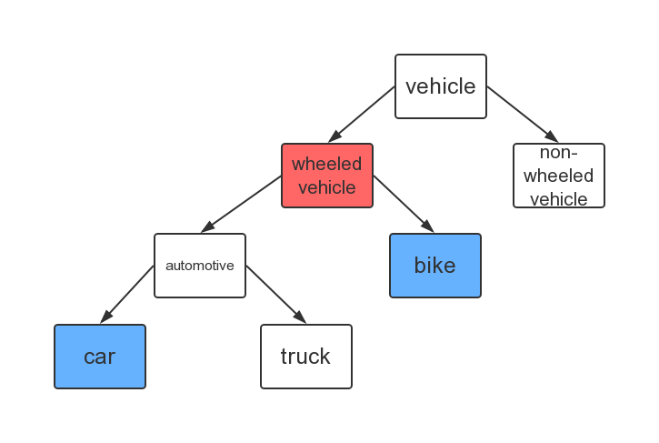

Slide 18
Related Work
Taxonomy based
  WordNet
  Least common subsumer
  Only good at similarity, rely on human efforts
Corpus based
  Rely on statistics counted from large corpus
  LSA, ESA

Slide 19
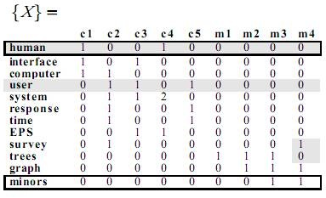
Latent Semantic Analysis (LSA)

Slide 20
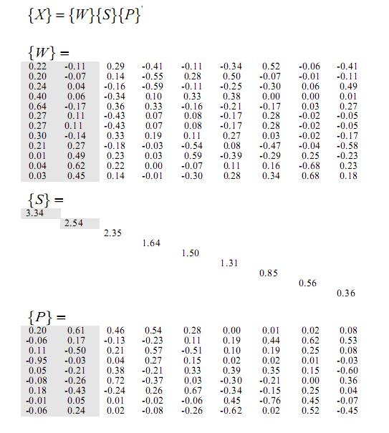

Slide 21
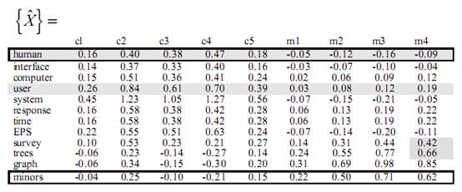
Latent Semantic Analysis (LSA)

Slide 22
Overview
Semantic Relatedness Computation
Related Work
Association Network
  Free Association Network
  Synthetic Association Network
Experiment Results

Slide 23
Overview
Semantic Relatedness Computation
Related Work
Association Network
  Free Association Network
  Synthetic Association Network
Experiment Results

Slide 24
Free Association
A technique used in psychoanalysis
Given a cue word, produce the first word that comes to mind
Several collections of data called free association norms

Slide 25
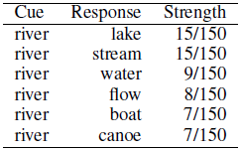
Free Association Norms

Slide 26
Free Association Network
Each node is a term
Each edge connects two associated terms
Weight along the edge is the association strength

Slide 27
Term Relatedness Computation
Two intuitions: A and B are related if
  Weight between A and B is large
  Neighbors of A and B are similar
Effectiveness and limitation
  Pretty good for terms in the network
  Not many terms are in the network

Slide 28
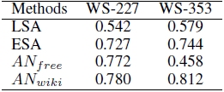
Effectiveness and Limitation

Slide 29
Overview
Semantic Relatedness Computation
Related Work
Association Network
  Free Association Network
  Synthetic Association Network
Experiment Results

Slide 30
Synthetic Association Network
Overcome the limitation of free association network
Based on 5 types of co-occurrences from Wikipedia
Use free association network for training

Slide 31
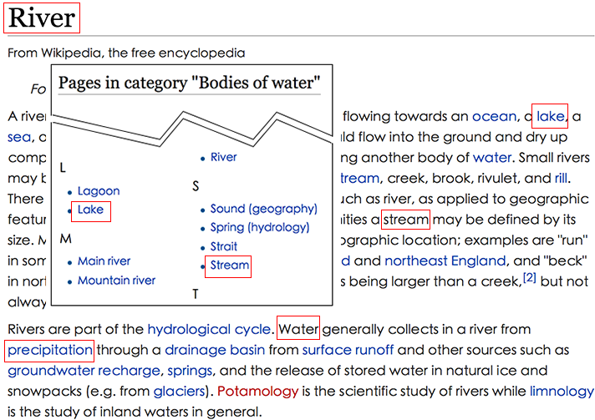
5 Types of Co-occurrences

Slide 32


5 Types of Co-occurrences

Slide 33
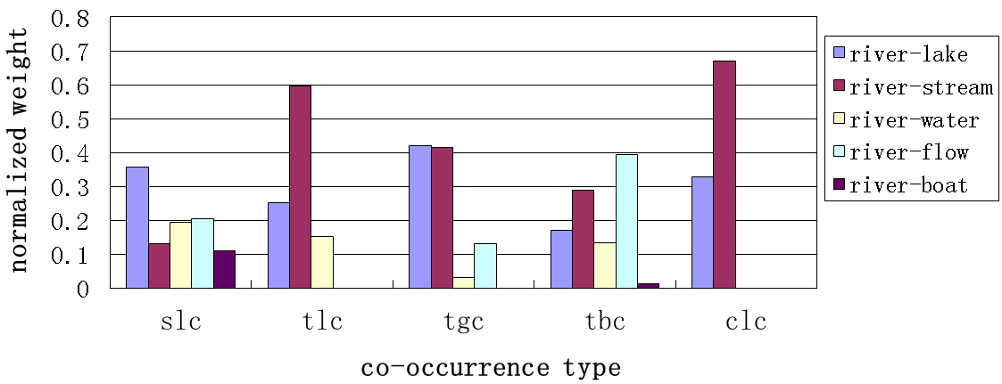
5 Types of Co-occurrences

Slide 34
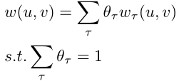

Weights Training
Weighted sum (linear combination)
Linear regression
  Instances: term pairs in free association
  Features: five types of
  Label: strength from free association network

Slide 35
Overview
Semantic Relatedness Computation
Related Work
Association Network
  Free Association Network
  Synthetic Association Network
Experiment Results

Slide 36
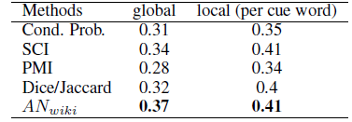
Predict Association
Correlation with test set
Upper bound for global is 0.40

Slide 37
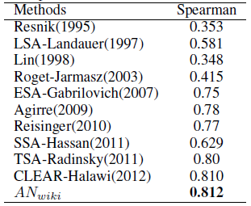
Term Relatedness

Slide 38
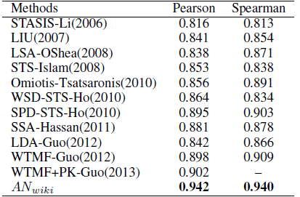
Sentence Relatedness

Slide 39

Two Contributions

Slide 40
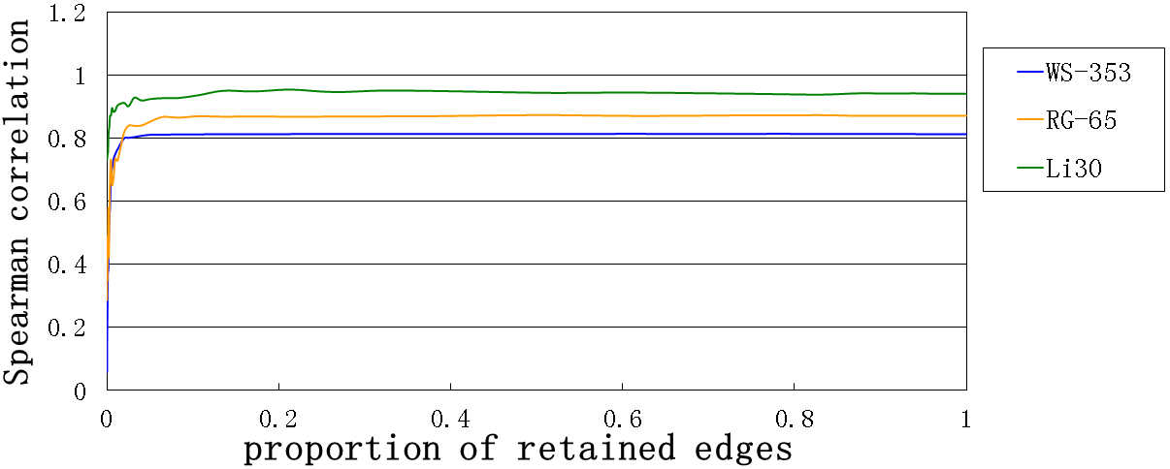
Execution Time and Scalability

Slide 41
Online Demo
http://adapt.seiee.sjtu.edu.cn:8080/ANdemo/
Two end-to-end applications
  Term Relateness
  Sentence Relatedness
Broswer over the association network

Slide 42
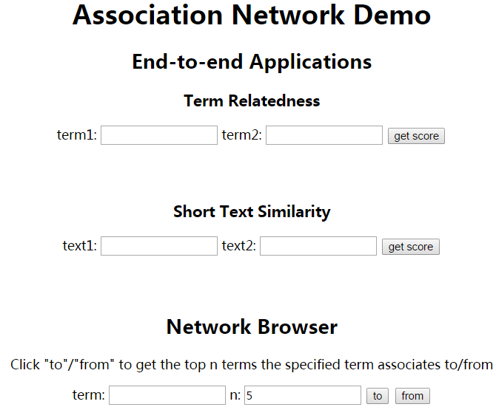

Slide 43
Thanks!
Keyang
2014/10/8

